Slide 1
Basics of Technical Writing
Catherine Xu
April 14th, 2016

Slide 2
Agenda
1 | Introduction
2 | Key Factors
3 | Best Practices for Engineers
4 | Summary
5 | Reference
6 | Q&A

Slide 3

Brainstorming
Notes:
CPU: Central Progressing Unit

Slide 4

What is Technical Writing?
Technical writing is any written form of writing or drafting technical communication used in a variety of technical and occupational fields, such as computer hardware and software, engineering, chemistry, and finance. IT encompasses the largest sub-field within technical communication.
Major categories:
Reports
Technical Papers
Patents
Notes:
CPU: Central Progressing Unit

Slide 5

Before You Begin
Identify your audience and their expectations
Know your purpose and material
Understand the writing task at hand
Organize your thoughts and materials
Budget adequate time to write, review, revise, and edit

Slide 6
Key Factors

Slide 7
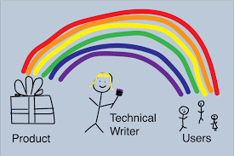
Key Factors for Technical Writing
Clarity
Brevity
Consistency
Active Voice
Present Tense
Notes:
CPU: Central Progressing Unit

Slide 8
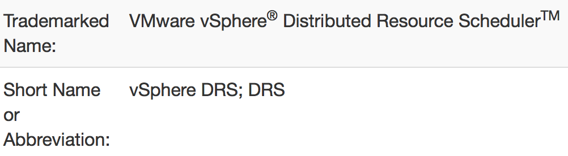
Clarity
Define the unfamiliar: define the term in its first occurrence and put abbreviations in parentheses
Example 1: disaster recovery (DR)
Example 2:
Avoid Jargon: a vocabulary particular to a place of work
Notes:
BC: business continuity
DR: disaster recovery
CPU: Central Progressing Unit

Slide 9
Clarity: Ambiguity
Choose words whose meanings are clear:
Original:
T cells, rather than B cells, appeared as the lymphocytes migrated to the thymus gland.
Revision:
T cells, rather than B cells, appeared because the lymphocytes migrated to the thymus gland.
Notes:
CPU: Central Progressing Unit

Slide 10
Clarity: Long Sentences
Original:
This solution provides many benefits including reducing data volume for non-production systems, offering high-quality business-relevant and up-to-date test data for development and training activities, and providing low administrative cost and time for maintaining non-production systems.
Revision:
This solution provides many benefits including:
Reducing data volume for non-production systems.
Offering high-quality business-relevant and up-to-date test data for development and training activities.
Providing low administrative cost and time for maintaining non-production systems.

Slide 11

Clarity: Noun Strings
Example
Original: The virtualized environment storage performance
Revision: The storage performance for the virtualized environment

Slide 12
Brevity: Use Words Efficiently
Never use two words when one word will do
Less is More
Phrases | Words
made arrangements for | arranged
made the decision | decided
made the measurement of | measured
Performed the development of | developed
Is working as expected | Works as expected
Notes:
Save localization costs

Slide 13
Brevity: Needless Complexity
Simple Wording
Category | Example | Substitute
nouns | utilization | use
 | functionality | feature
verbs | facilitate | cause
 | finalize | end
adjectives | aforementioned | mentioned
 | individualized | individual
adverbs | firstly, secondly | First, second
 | heretofore | previous
Notes:
CPU: Central Progressing Unit

Slide 14
Consistency
Wording
Term consistency
Heading/List word usage
Example: hard drive, hard disk, HDD
Format
Heading: heading style versus sentence style
Table/Figure
List
Notes:
List: sentence structure is in parallel

Slide 15
Consistency: List
Bulleted list − Use a bulleted list when describing alternatives that have no sequence or priority. In a bulleted list, changing the order of the items should have no detrimental effect.
Numbered list − A numbered list is not a procedure but a list of high-level tasks that have a prescribed sequence or options that are organized by priority.

Slide 16
Consistency: Number
Spell out numbers lower than 10 (unless they are used with a unit of measure).
Example:
Only five users are online.
Wait 5 seconds before restarting the machine.
If numbers are used with parallel items in a sentence and one of the numbers is 10 or higher, use numerals for all the parallel items.
Example:
Only 5 users are online, but 25 users subscribe to the service.
When using the abbreviation for a unit of measure with a number, put no space between the number and the abbreviation.
Example:
8GB
8 gigabytes

Slide 17
Active Voice
Active: use active voice whenever possible.
Original: Until a browser is added to the preceding list, its use with the product is not supported.
Revision:
Until VMware adds a browser to the preceding list, you cannot rely on product support for that browser.
Use passive voice only when the performer is unknown or irrelevant.
Example:
When the VMware vCenter Server Install menu is displayed, click vCenter Server.

Slide 18
Present Tense
Write in the present tense unless an action can be performed only in the future or must have occurred in the past. Present tense is clearer and more concise.
Original: When you have selected this command, Webtop Client will open the repository.
Revision: When you select this command, Webtop Client opens the repository.

Slide 19
Best Practices for Engineers

Slide 20
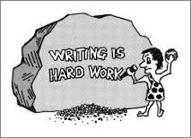
Best Practices
Terminology and Product Name
Word Choice
Grammar, Grammar, Grammar!
Article
Punctuation
Diagram Matters
Good Use of Reviews
Legal Check
Let Word Help You

Slide 21
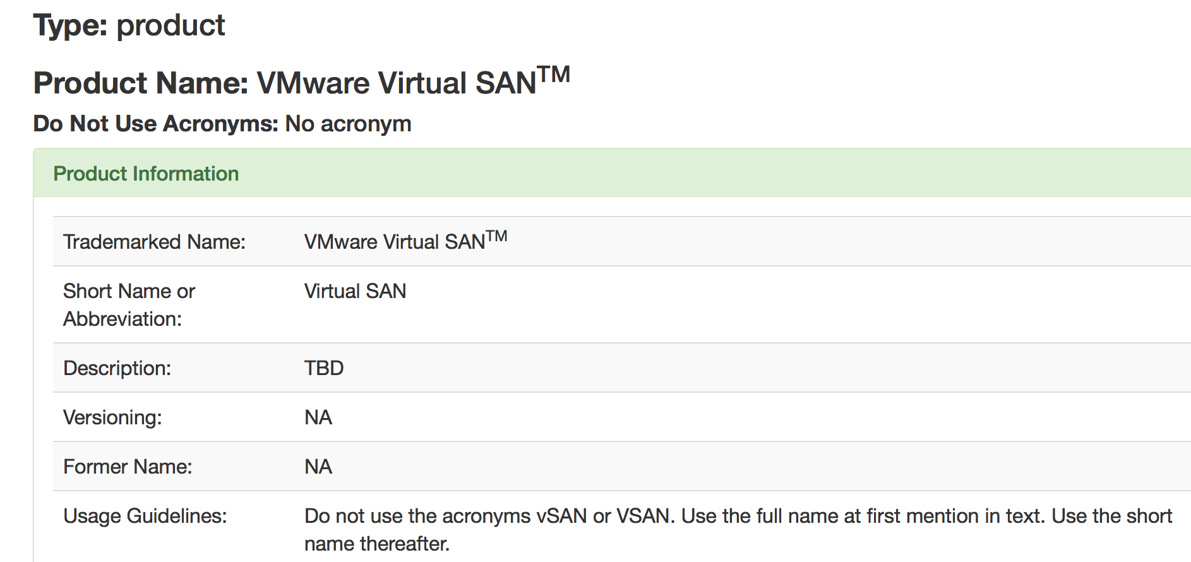
Terminology and Product Name
Stick to the VMware Product Names DB for product name writing. Write with the company name on its first reference.

Slide 22
Word Choice: Avoid Using Latin Abbreviations
Latin Abbreviation | Full Name
e.g. | for example
et al. | and others
etc. | and so on
i.e. | that is
vs. | versus

Slide 23

Word Choice: Do Not Use “Please”

Slide 24
Grammar: Articles - A versus An
Initialism - an SRDF
Abbreviation formed from the initial letters of several associated words, but each letter is pronounced separately, such as HTML, PDF, RPC.
Acronym - a MIB
Abbreviation of a word formed by taking the first letters, or several letters, of many words to form syllables used and pronounced like words, such as ASCII, DOS, RAM.
Notes:
SAP?

Slide 25
Grammar: Punctuation
Big rule of thumb: establish your authority right away with consistent punctuation.
No exclamation marks
Comma usage when writing a “triplet”
Original: EMC Symmetrix VMAXe storage offers storage with high performance, scalability and security.
Revision: EMC Symmetrix VMAXe storage offers storage with high performance, scalability, and security.
Use a hyphen to connect the adjective to the noun in compound expressions: first-rate increase

Slide 26

Diagram Matters
Diagram wordings
Term consistency
Capitalization
GUI wording
Style
Font
Clarity

Slide 27

Good Use of Reviews
Technical Review
Editing Review

Slide 28
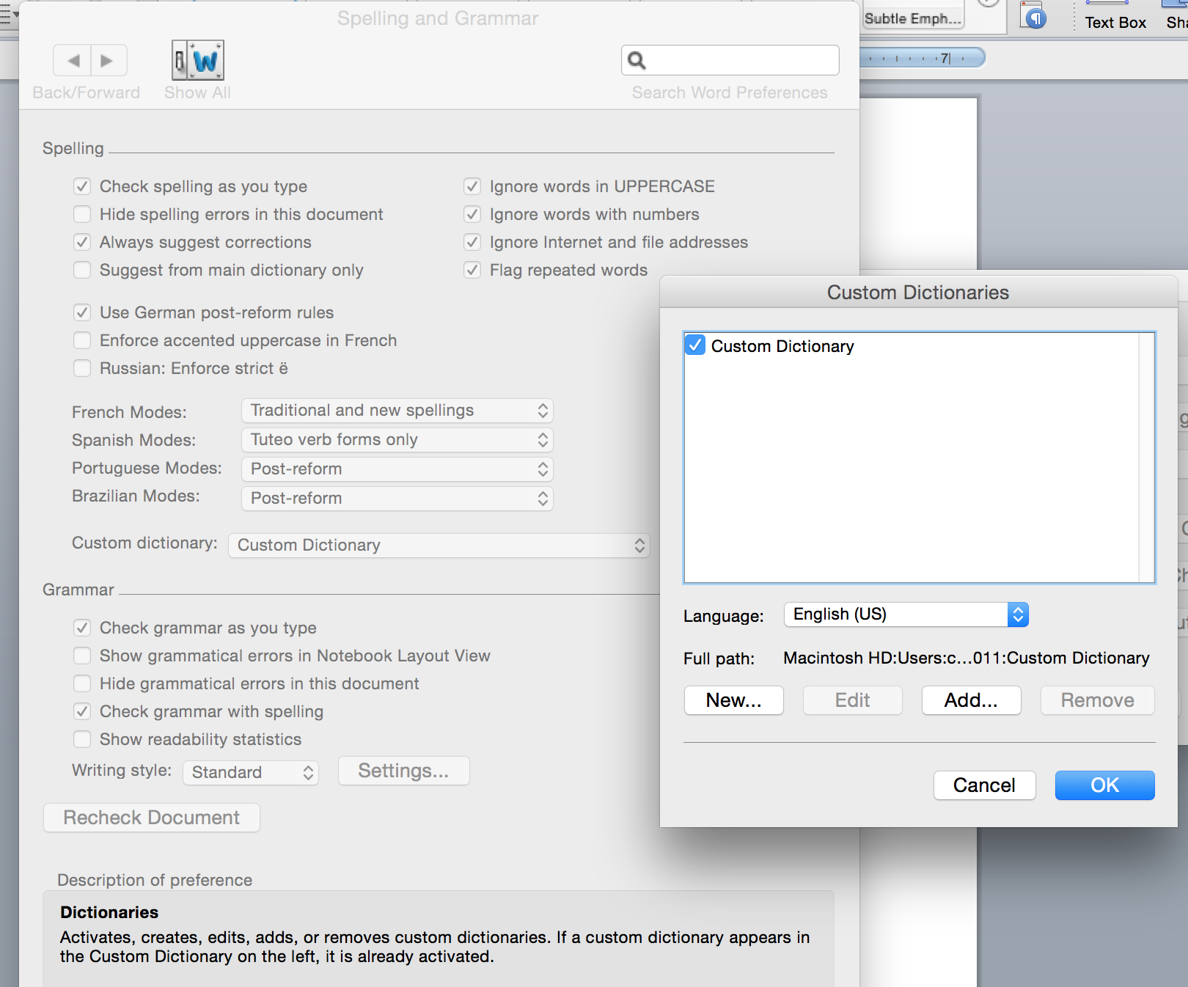
Let Word Help You
MAC Office 2011
Select English (US) as the custom dictionary in the Spelling and Grammar setting.

Slide 29
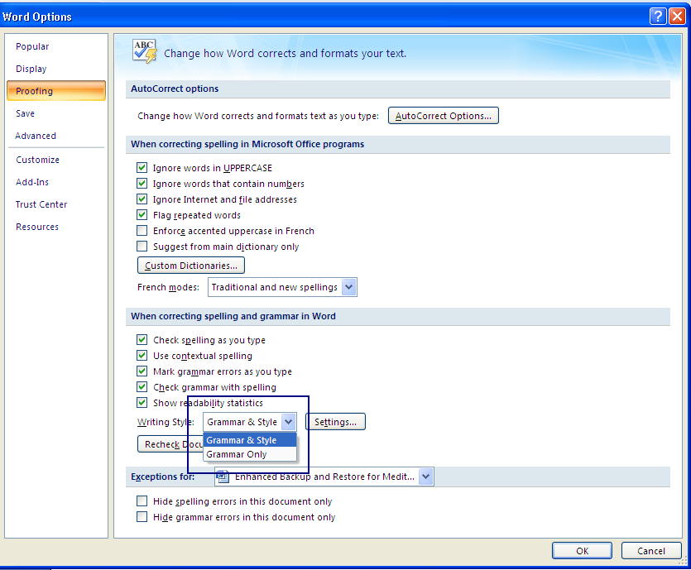
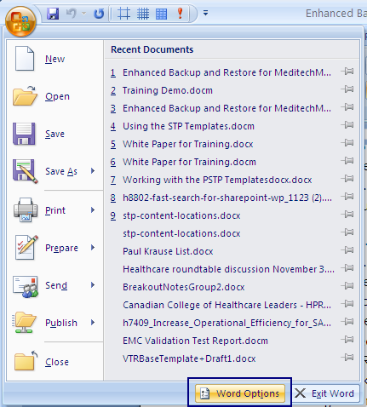
Let Word Help You - Continue
Windows Office 2013
Word has a built-in feature that highlights passive voice and helps to correct it. To activate that feature:
Choose Word Options from the Windows menu.
Choose Proofing.
Choose Grammar & Style from the “When correcting spelling and grammar” section.
Choose Grammar & Style

Slide 30

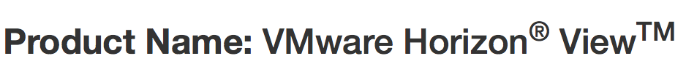
Legal Check
Trademark, copyright, and disclaimer
Patent process

Slide 31
Summary

Slide 32

To summarize
Plan your project before you begin drafting.
Understand basic qualities of good technical writing.
Adopt best practices for engineers.
Practice makes perfect.

Slide 33


Don’t worry, I’ve got your back

Slide 34
References
VMware Product Names
VMware Source: Templates and Guidelines
MIT Writing Center

Slide 35


Slide 36
Quiz
What are the key factors for technical writing?
Clarity
Brevity
Consistency
Active Voice
Present Tense
What are the full names of the following Latin abbreviations?
e.g.
vs.
etc.

Slide 37
Thank You
catherinex@vmware.com

